Slide 1
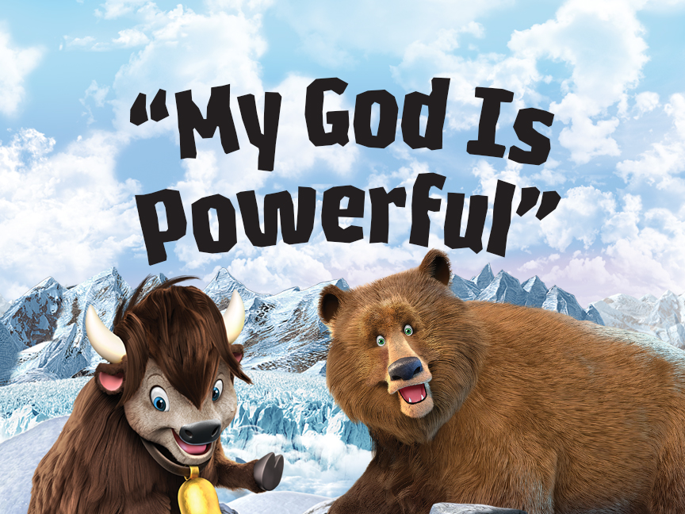

Slide 2

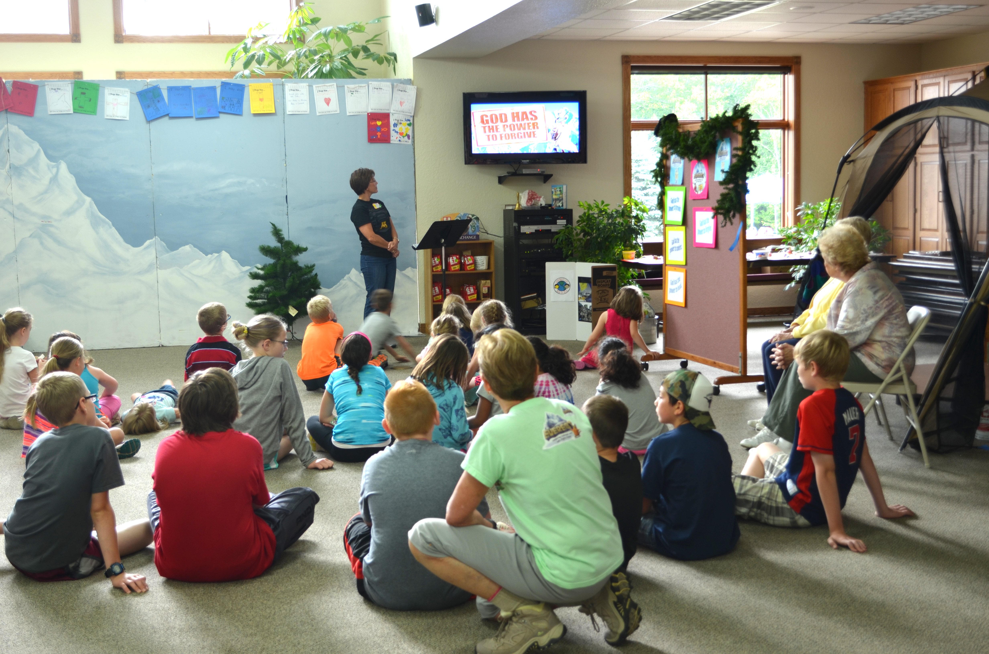

Preschoolers smiling

Slide 3
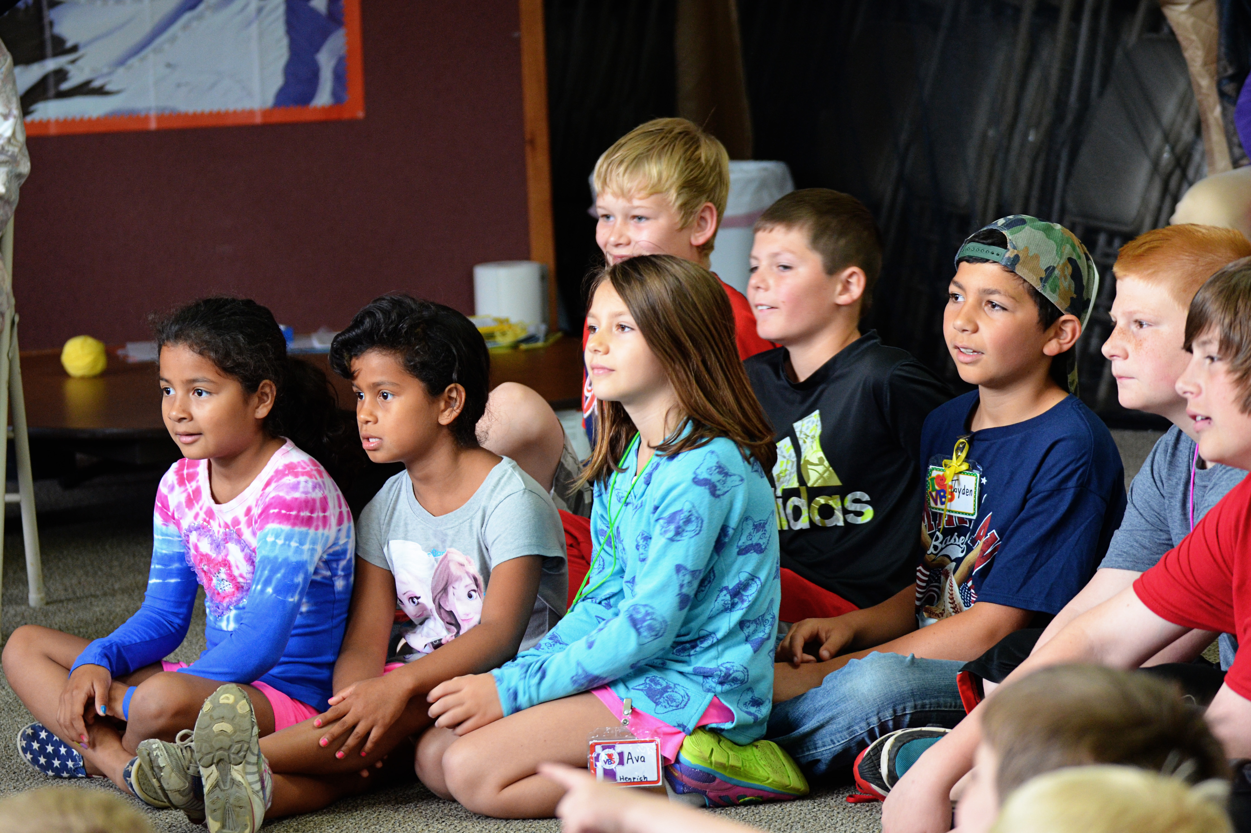
Preschoolers singing

Slide 4
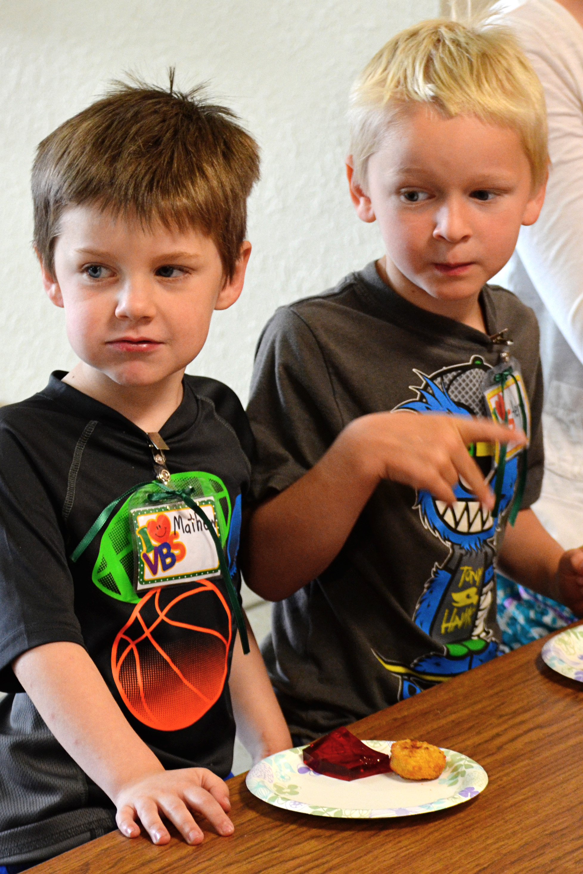
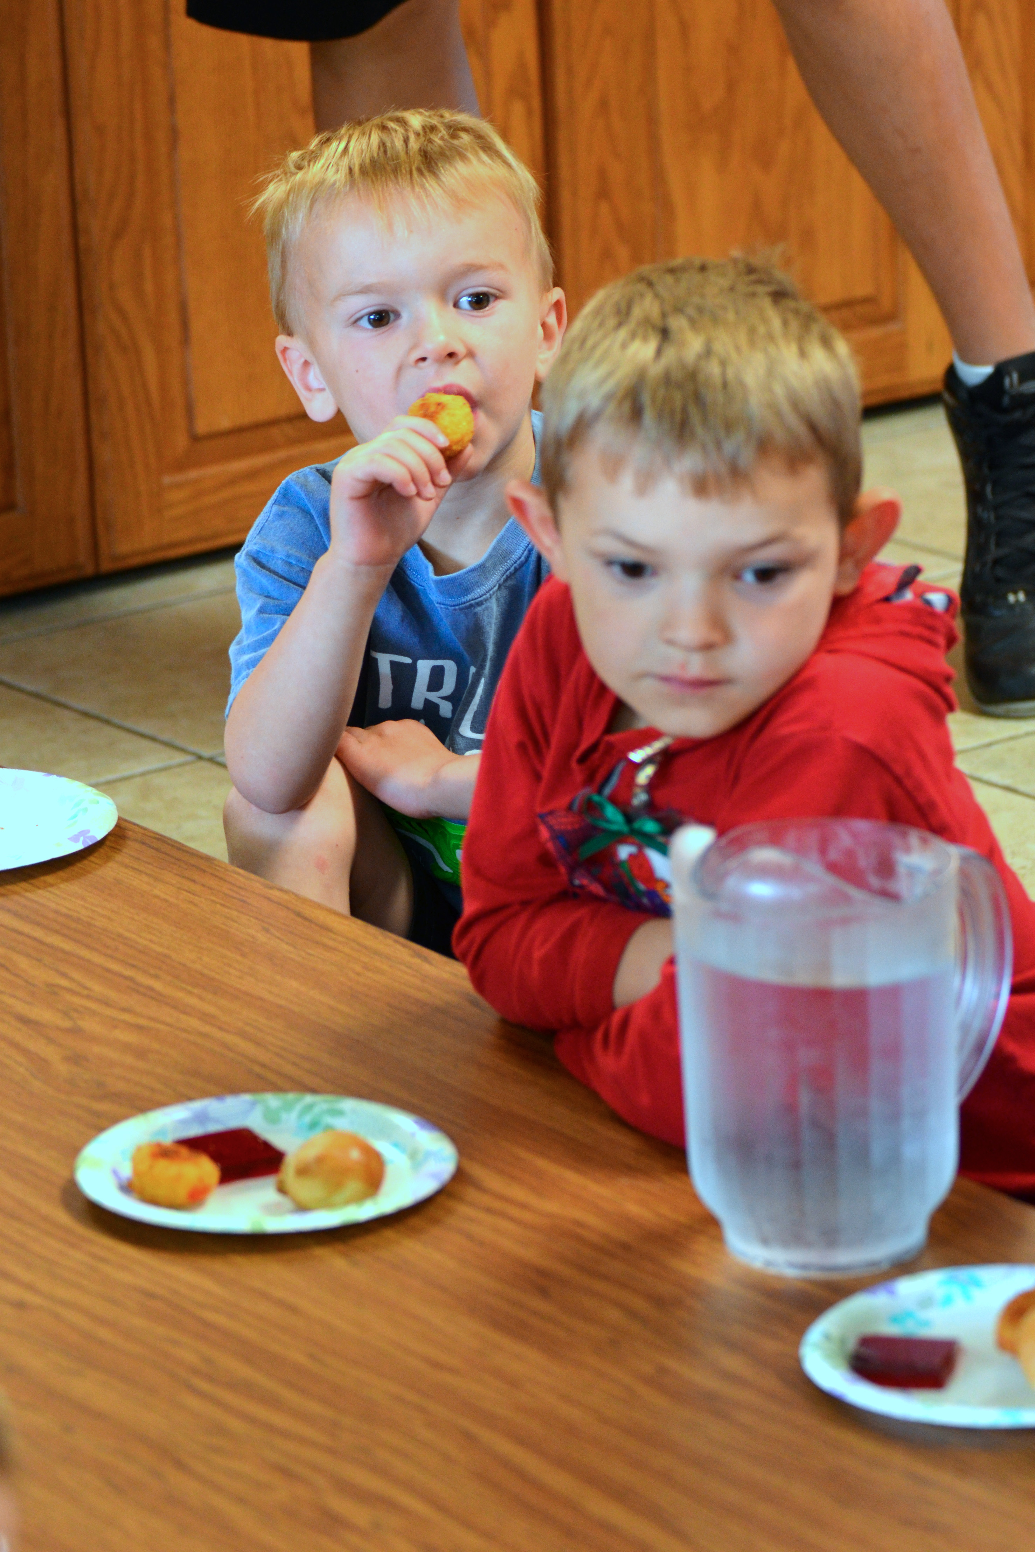

Slide 5
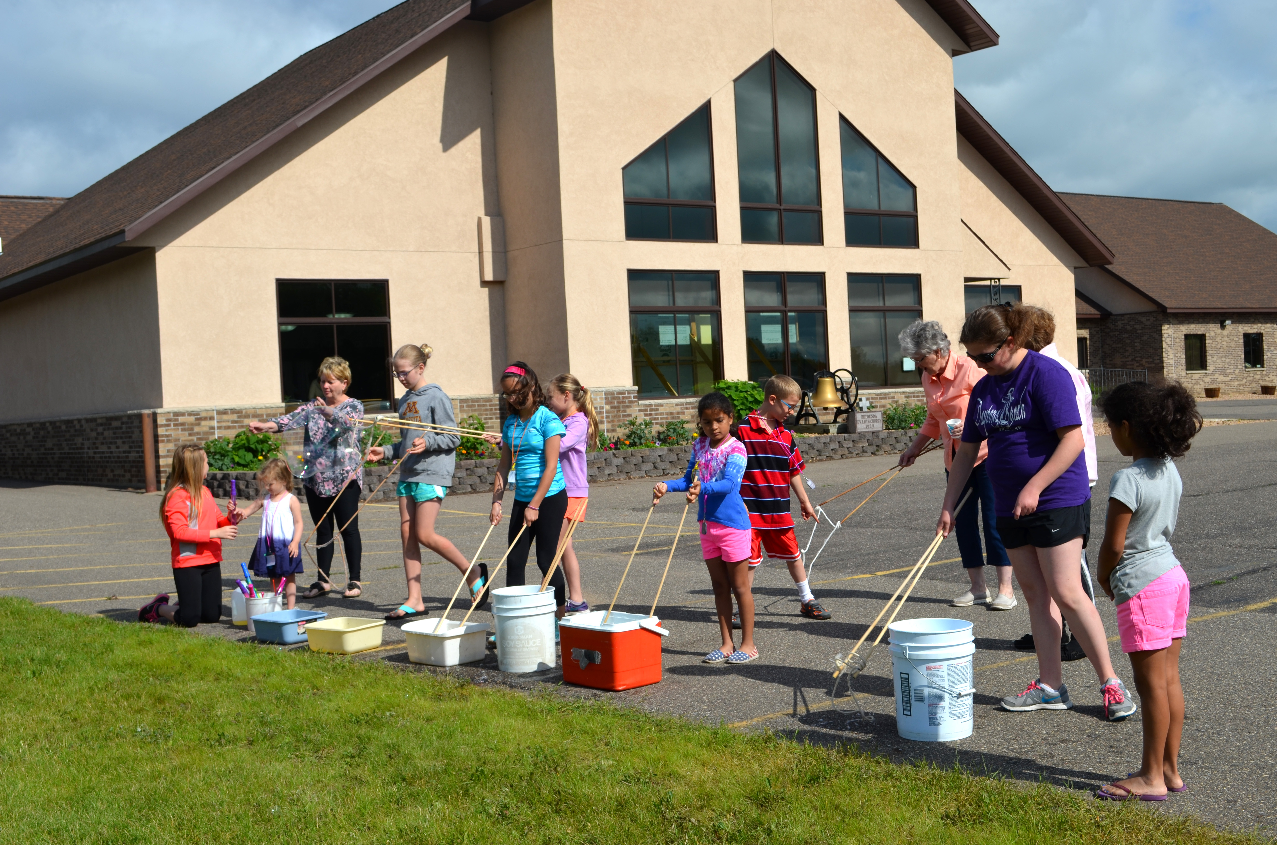
Preschoolers jumping

Slide 6
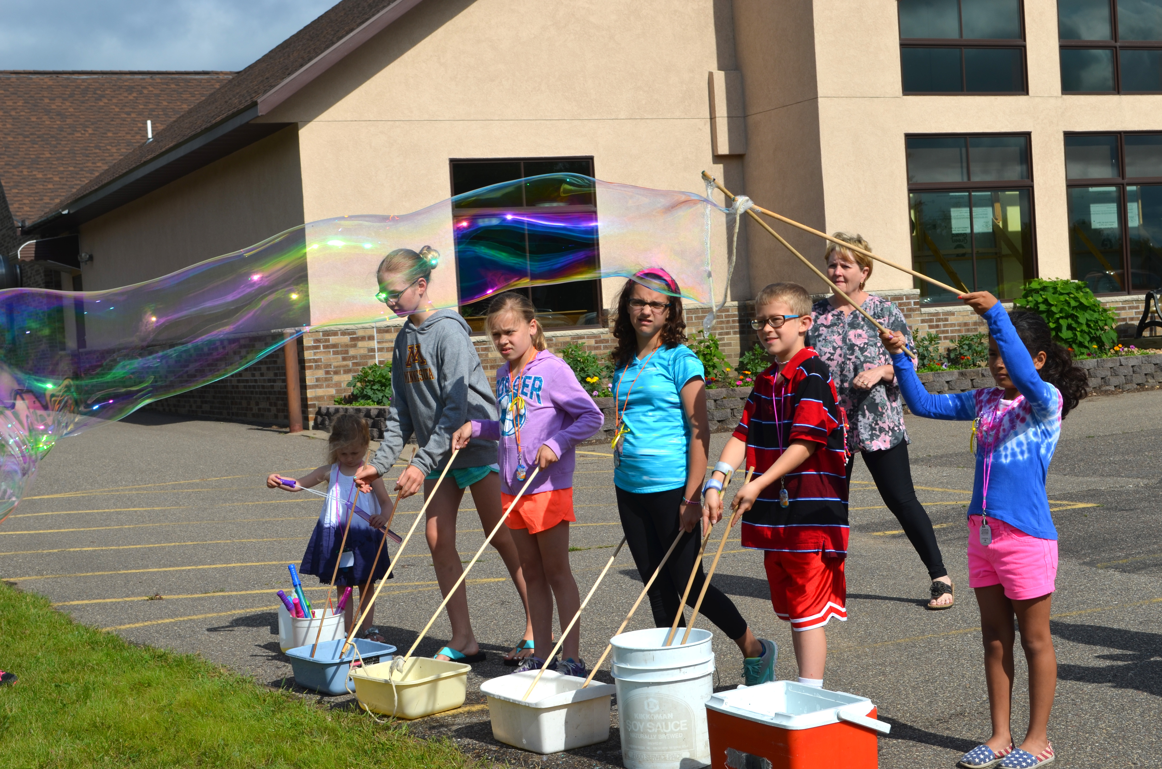
Preschoolers hugging each other or a Crew Leader

Slide 7
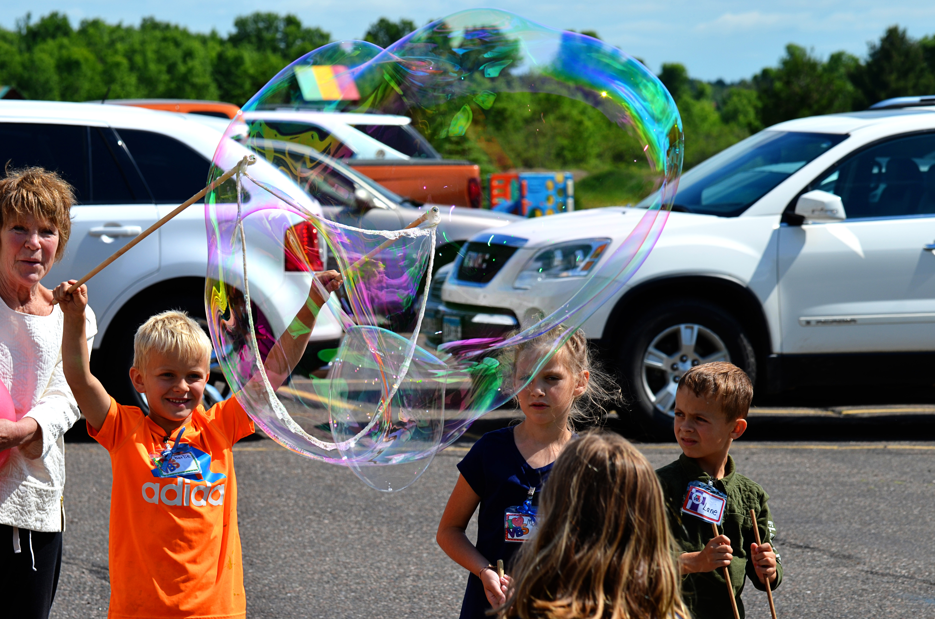
Preschoolers playing games

Slide 8
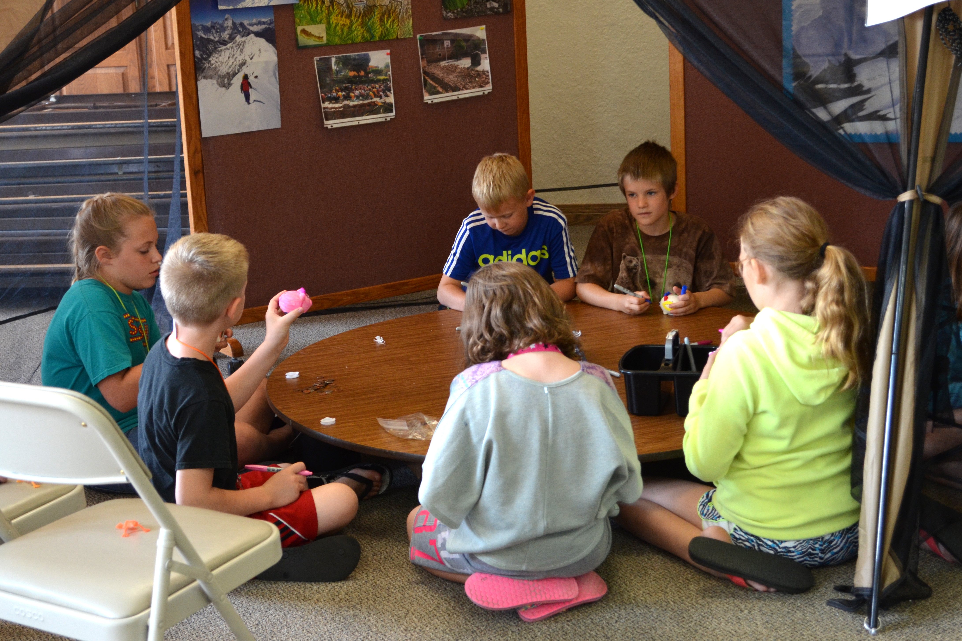
Preschoolers playing during Exploration Stations

Slide 9
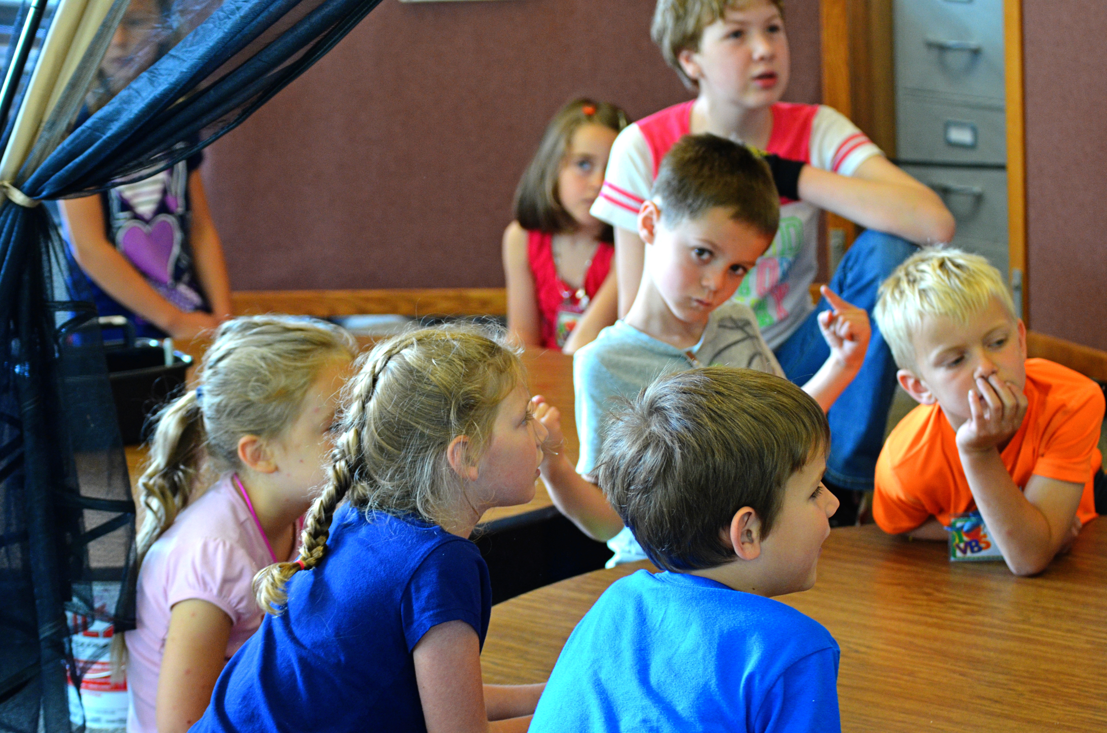
Preschooler receiving the day’s Bible Memory Buddy from his or her Crew Leader**

Slide 10
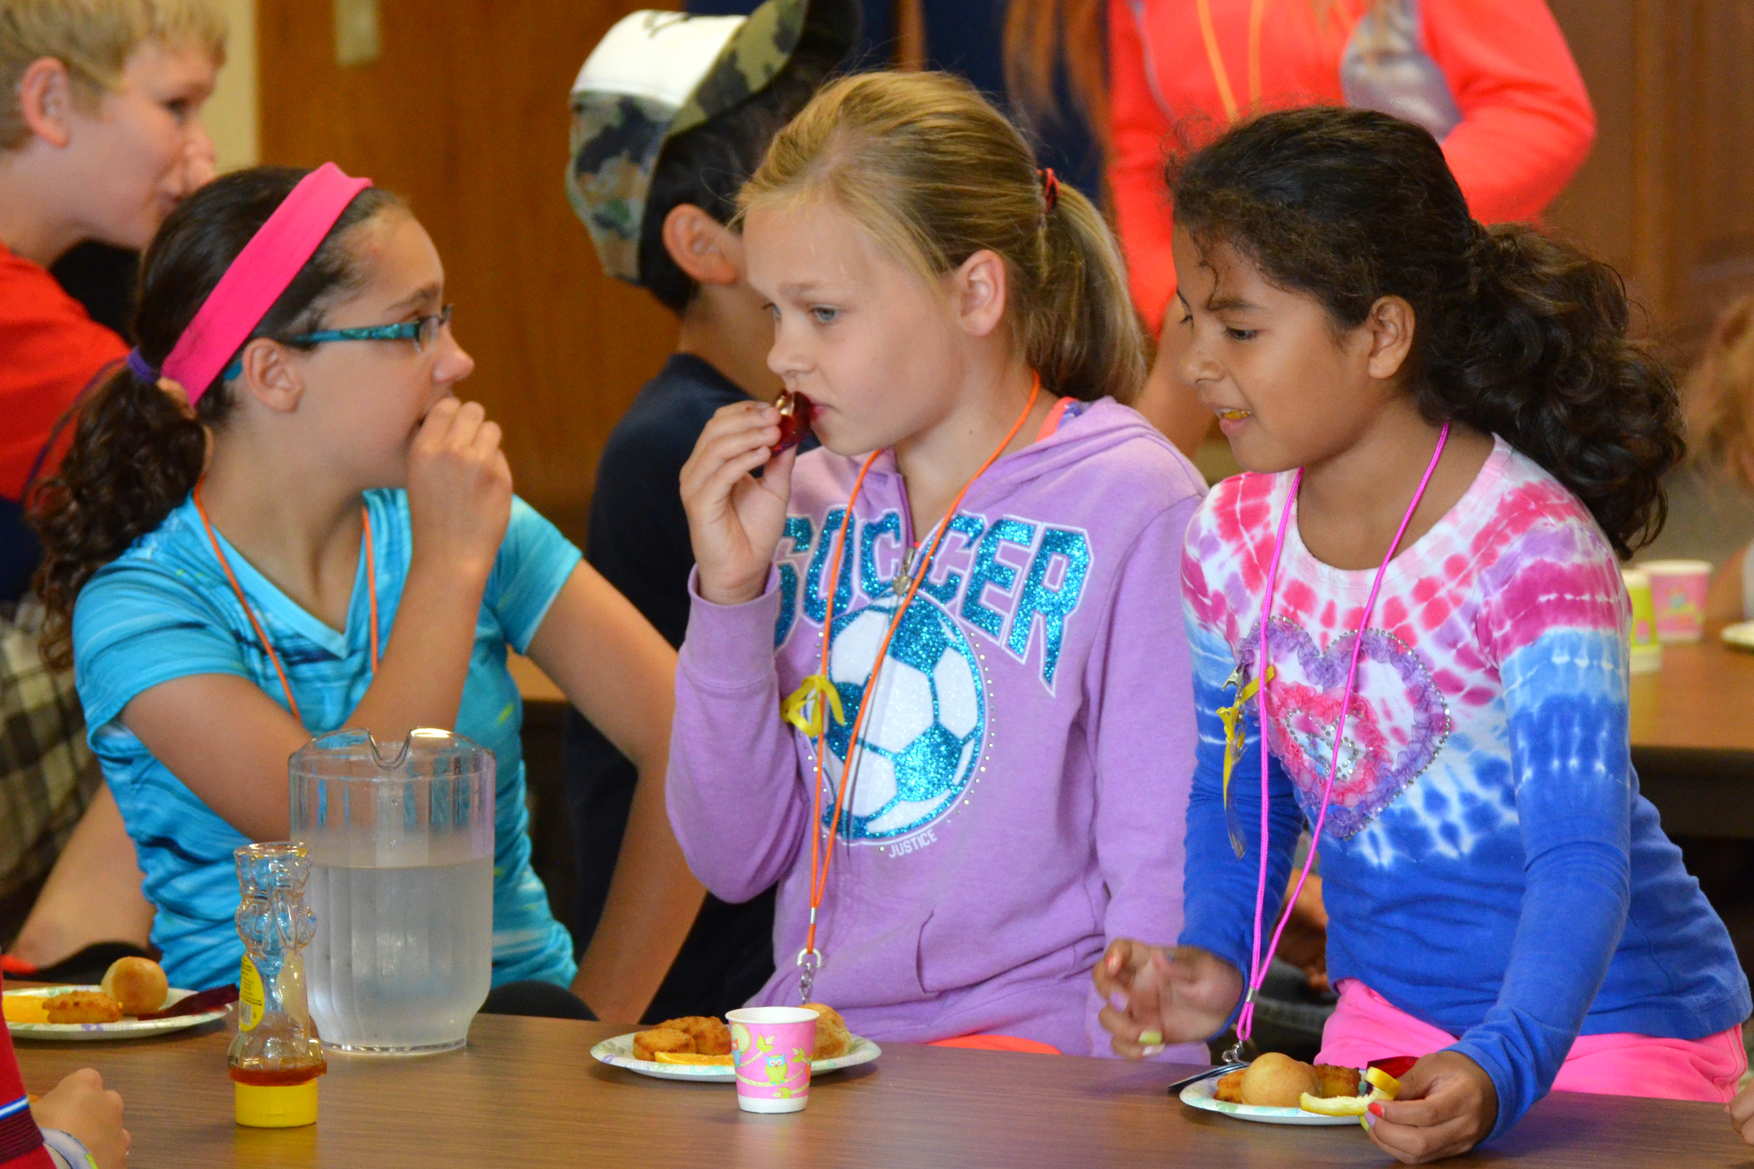
Preschoolers dancing and singing

Slide 11
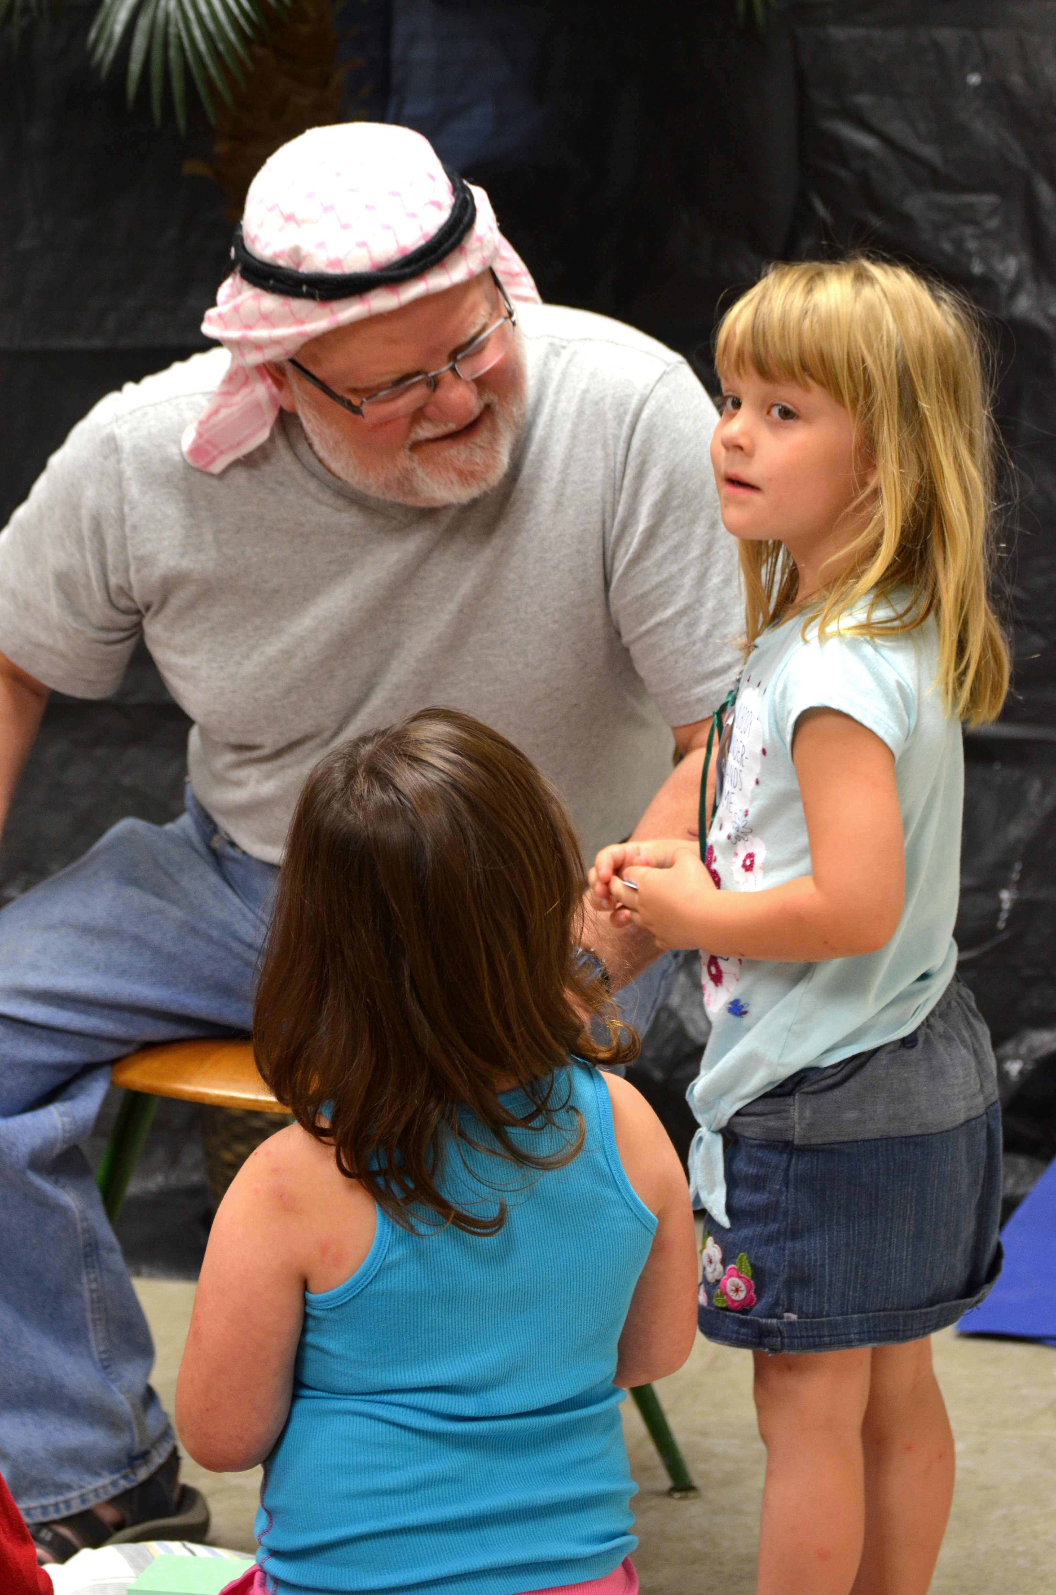
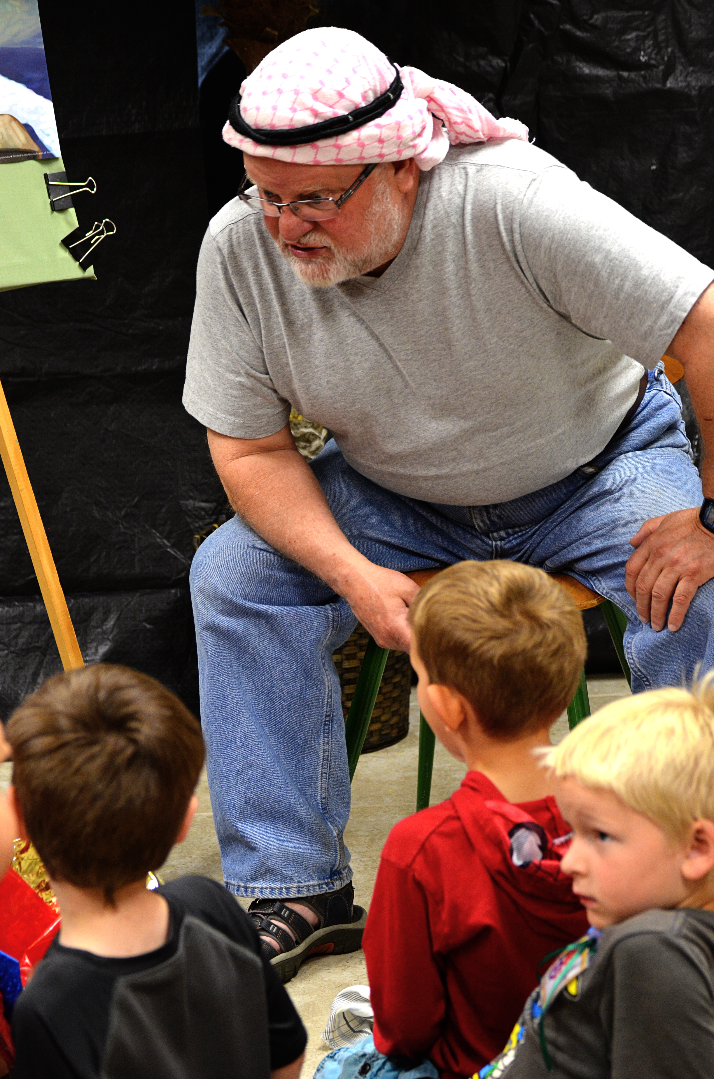

Slide 12
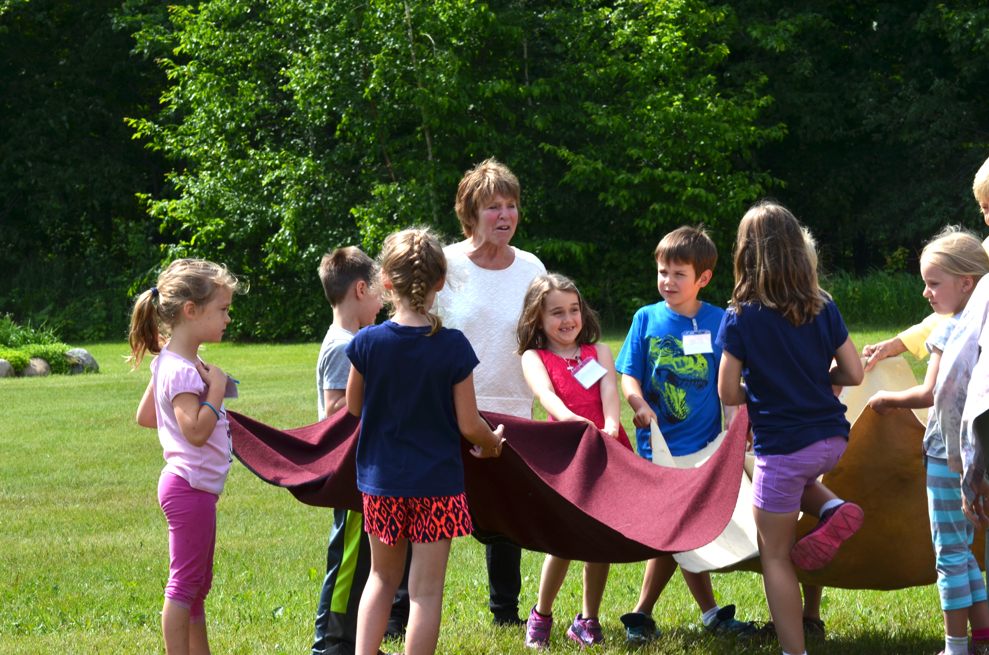
Preschoolers playing with Cool Cubes**

Slide 13
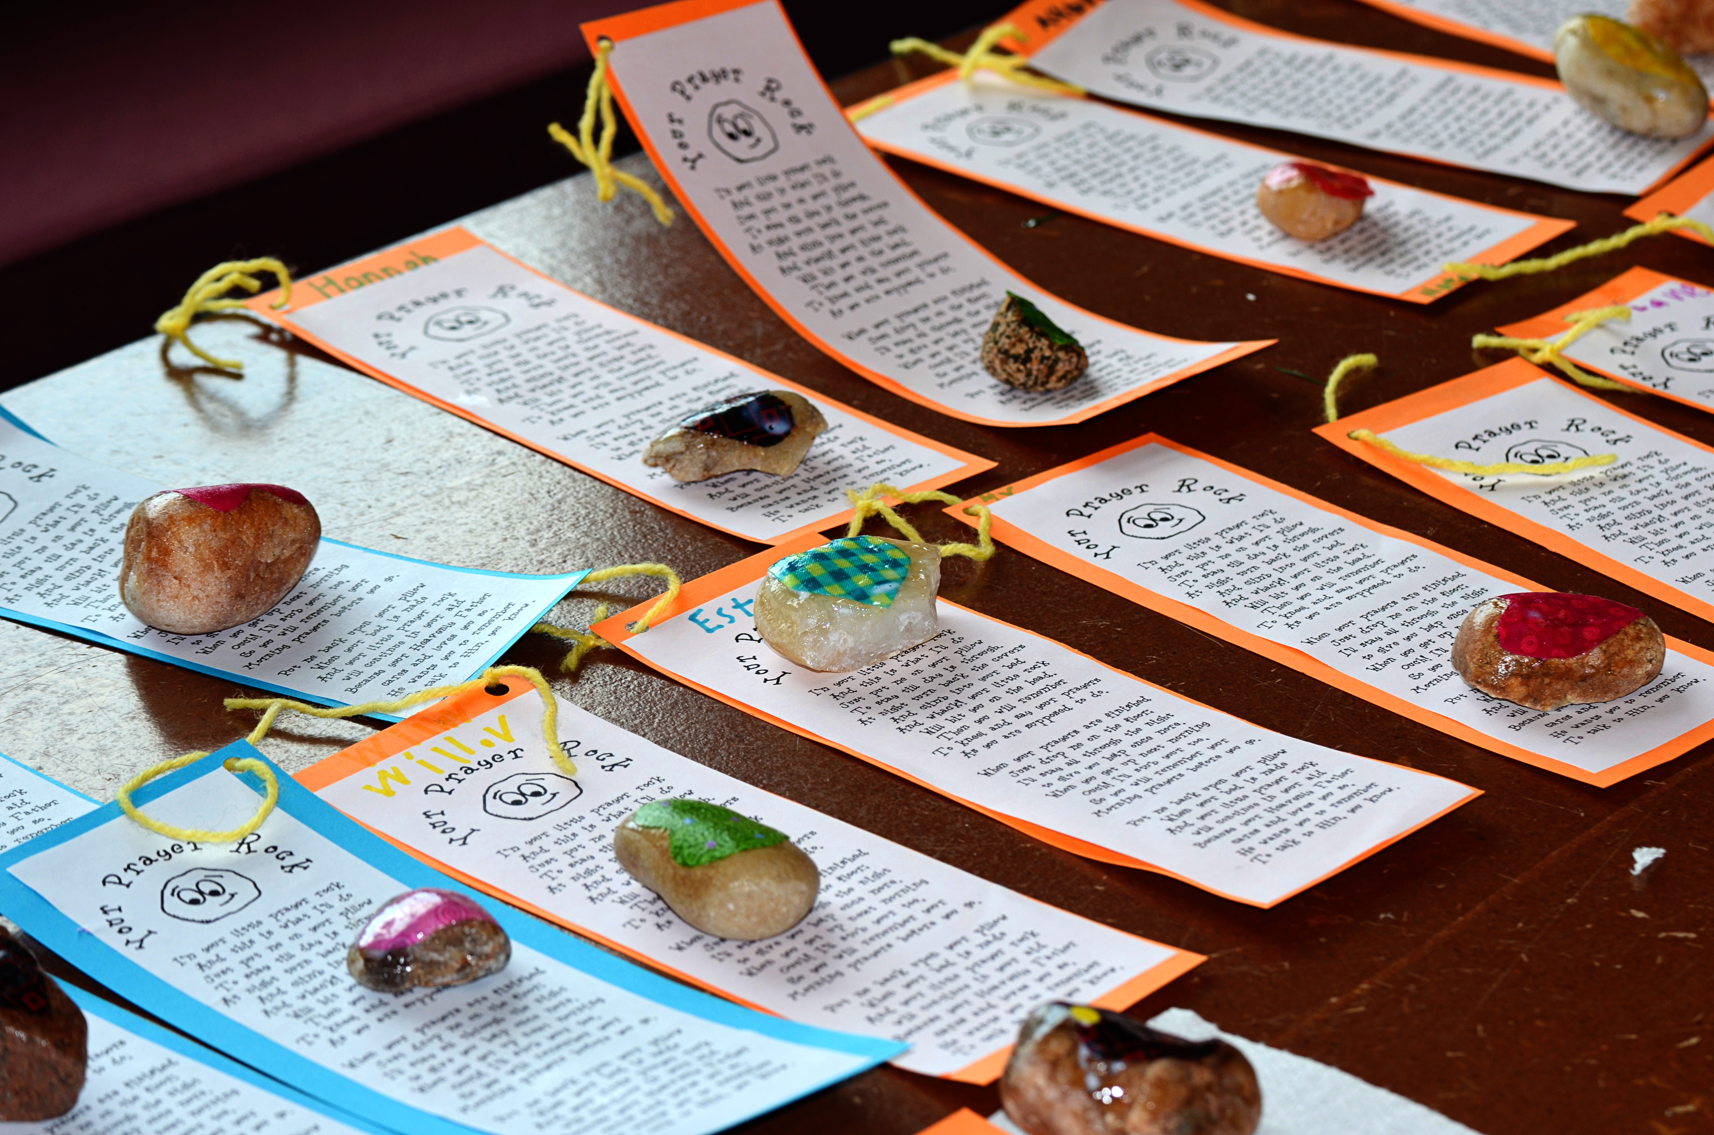
Preschoolers listening to their Station Leader during Bible Adventures & Missions
Prayer Rocks

Slide 14
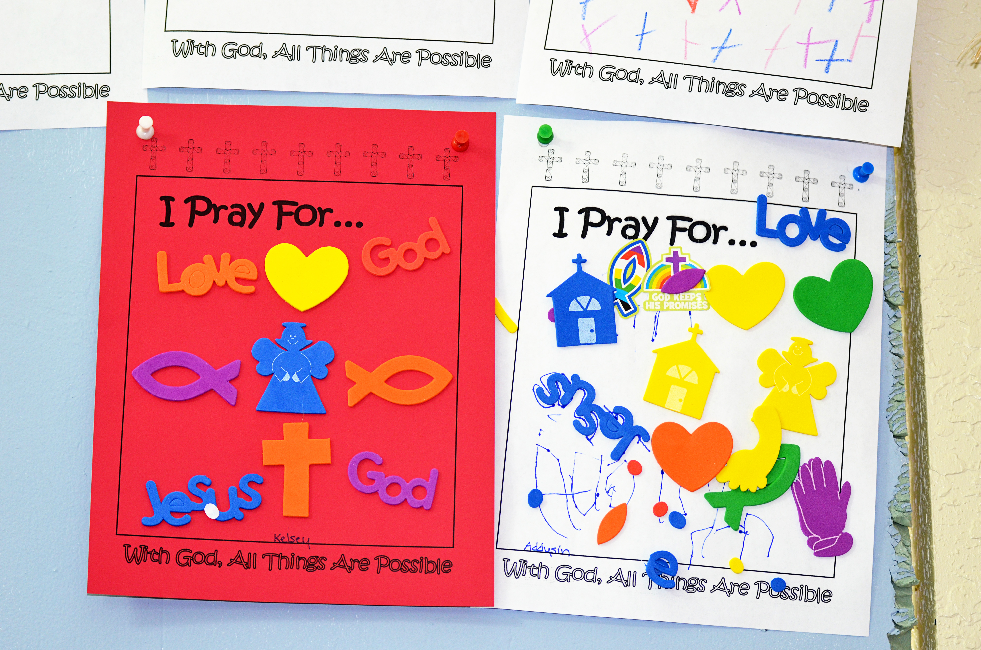
Preschoolers doing crafts
What we pray for

Slide 15
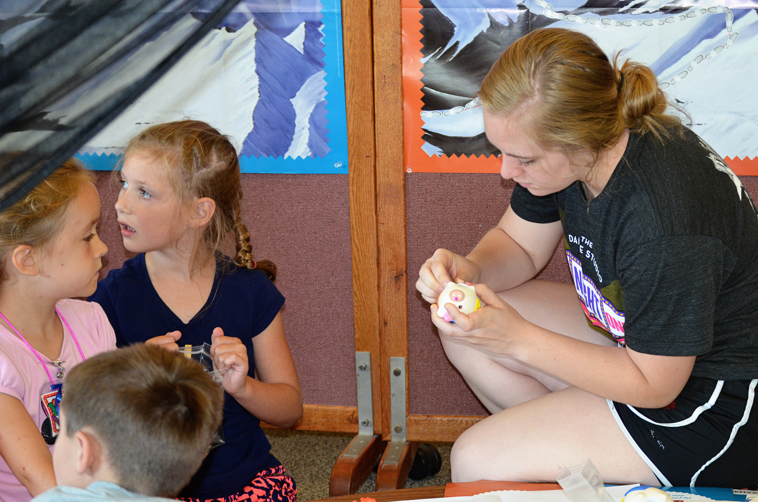
Happy preschool Crew

Slide 16
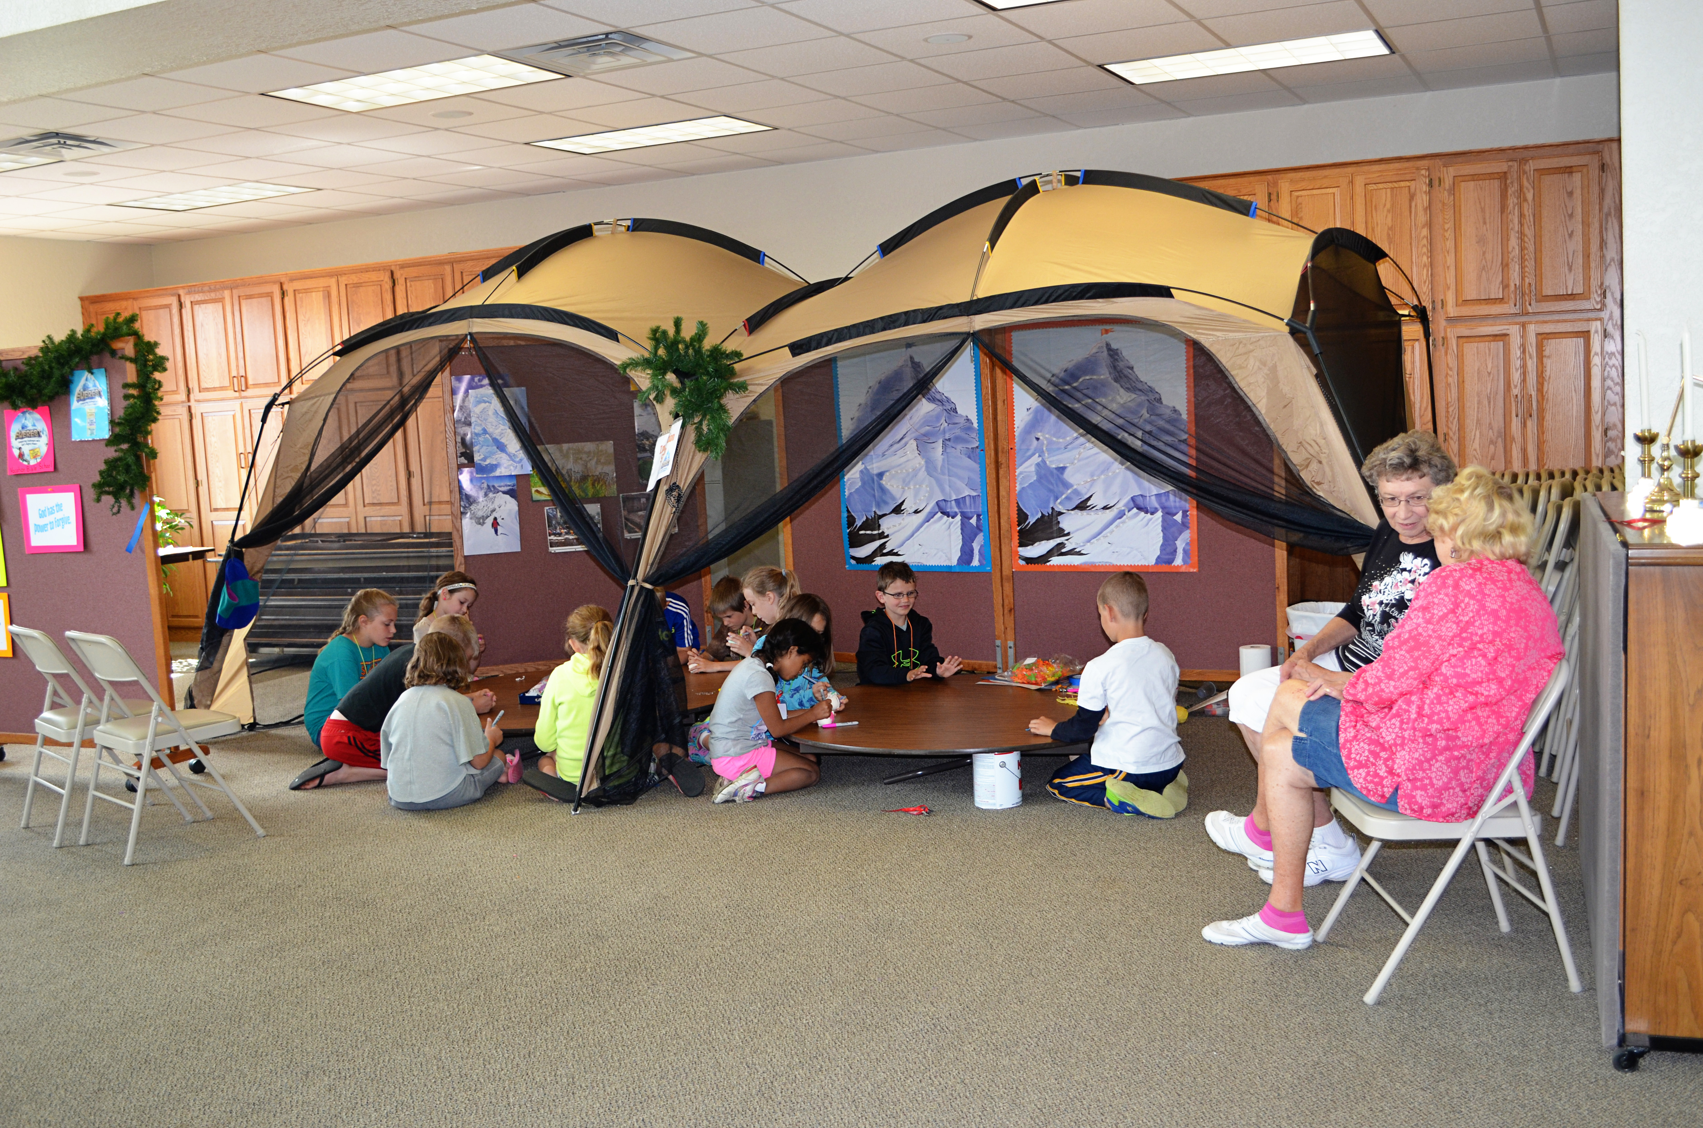
Preschoolers praying

Slide 17
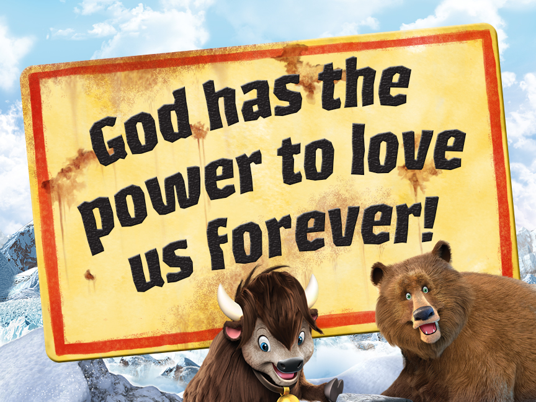

Slide 18


Slide 19
